Slide 1

ID Card Detection using a Pretrained Faster R-CNN model
Problem addressed : Detecting ID card from an image
Solution proposed : Faster R-CNN model
Group : D , Members ID : 20-41848-1, 20-42273-1, 20-42546-1, 18-38839-3, 19-40151-1

Slide 2
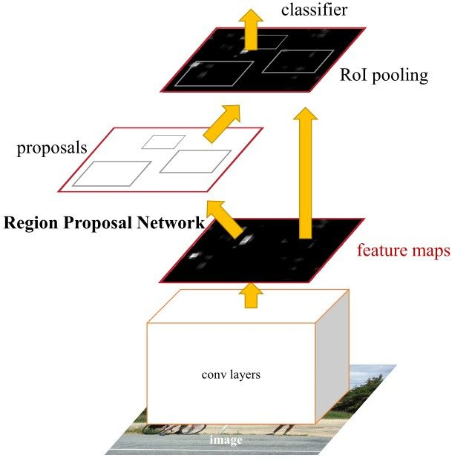
Why Faster R-CNN model ?
Region proposal generation with RPN
Better result for small dataset
State-of-the-art technique [1]
Source (https://medium.com/egen/region-proposal-network-rpn-backbone-of-faster-r-cnn-4a744a38d7f9)
[1] https://paperswithcode.com/task/object-detection

Slide 3
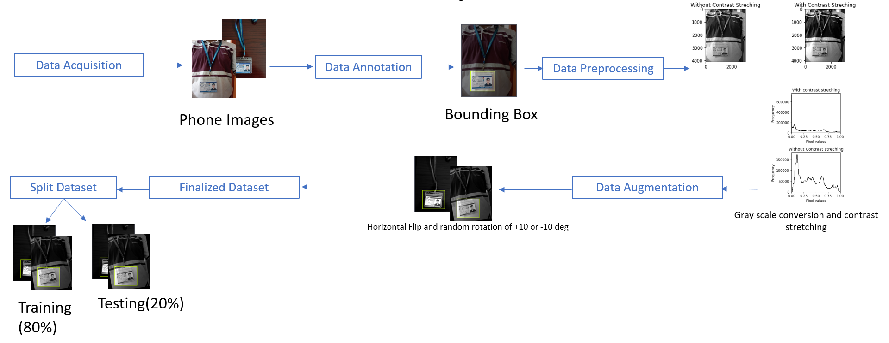
Proposed model
Data Acquisition to Data Set splitting

Slide 4
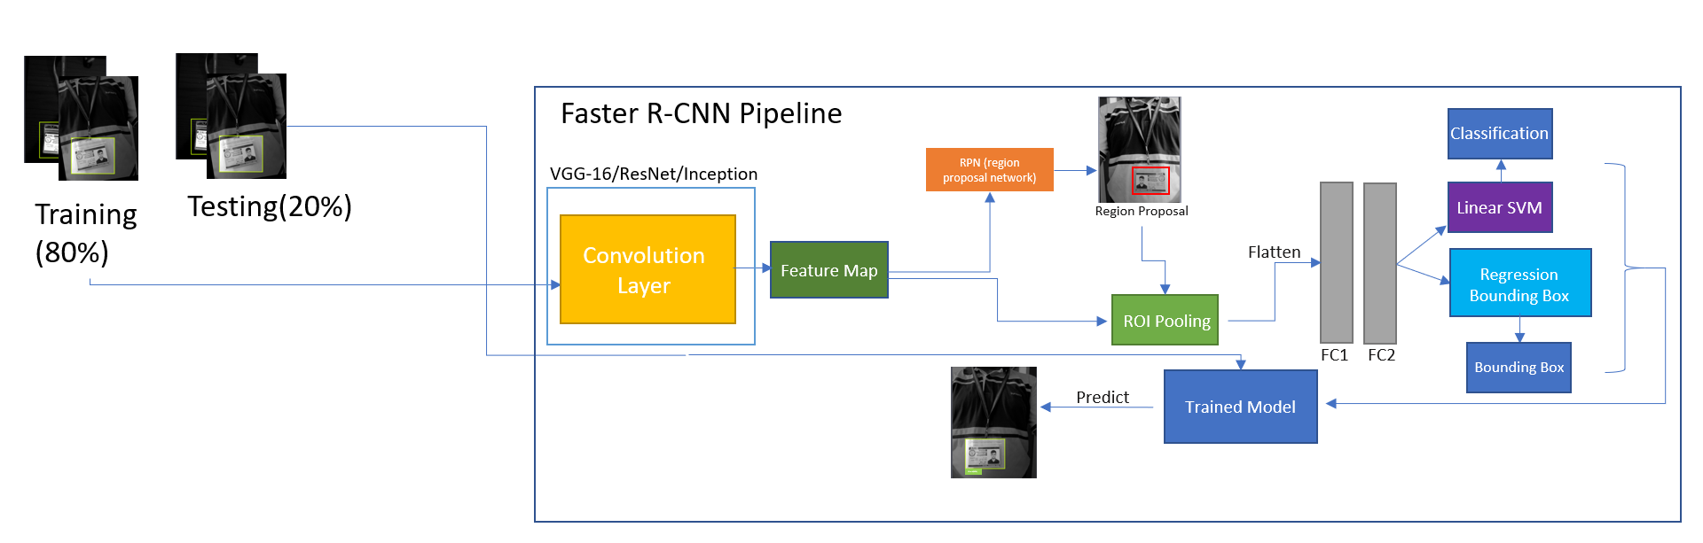
Proposed model
Model Training And Prediction

Slide 5
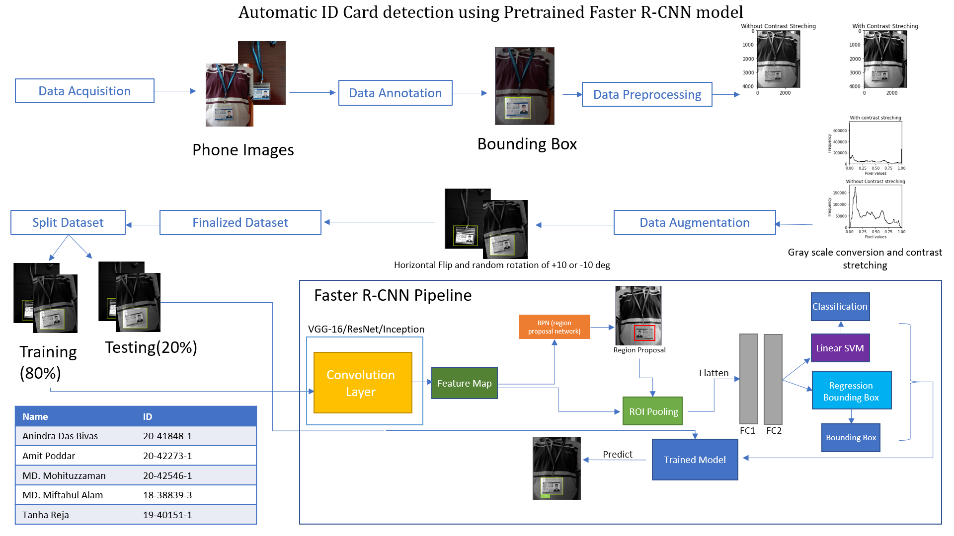

Proposed model
Data Preprocessing step
Data Augmentation Step
Data Set Build Up

Slide 6
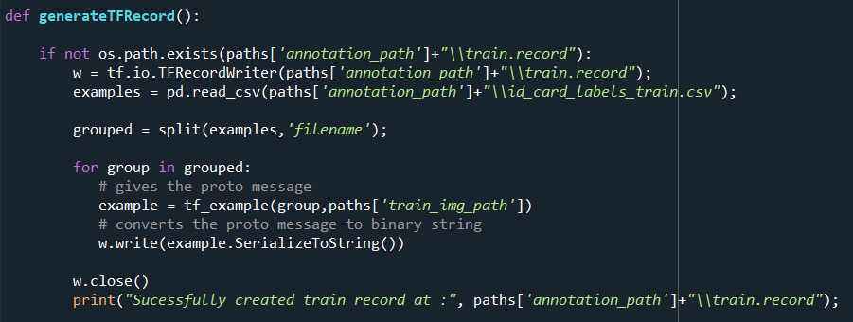
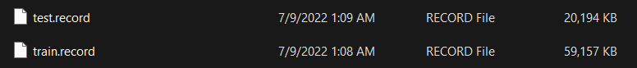
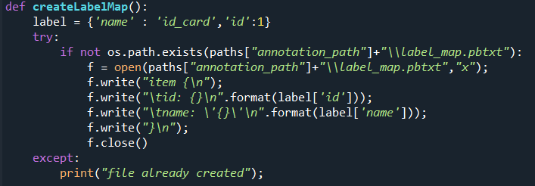
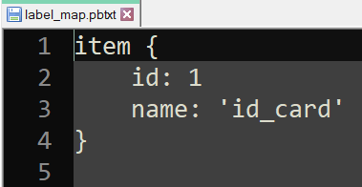
Present Work
Record file generation
labelmap generation

Slide 7

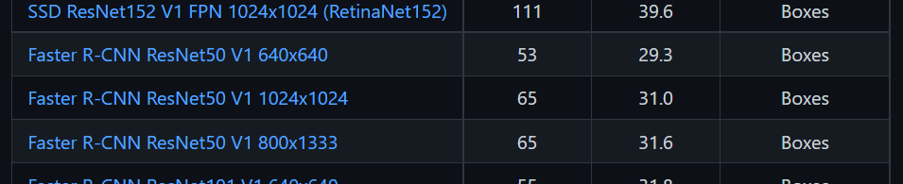
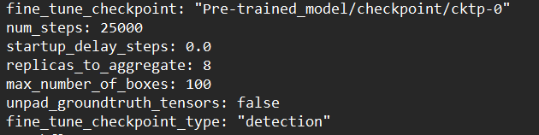
Present Work
Transfer Learning
Updating pipeline config
Loading Pretrained Model weights
Restores Feature Extractor

Slide 8
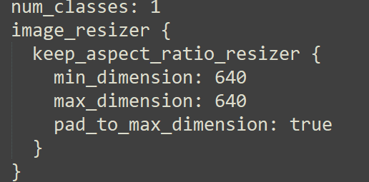
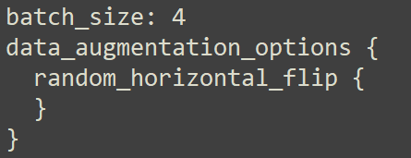
Present Work
Number of classes and preprocessing
Batch Size and data augmentation

Slide 9
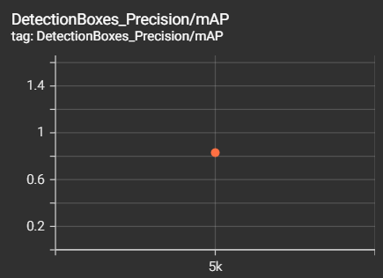
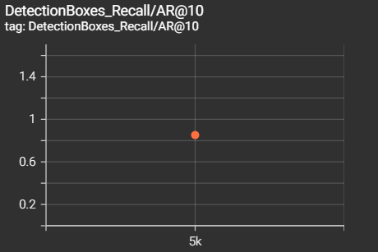
Model Evaluation
Average Precision : 0.831
Average Recall : 0.852

Slide 10
Model Evaluation
F-score = $\frac{2 ∗precision ∗recall}{precision+recall}$ = $\frac{2 ∗0.831 ∗0.852}{0.831+0.852}$ = 0.841

Slide 11
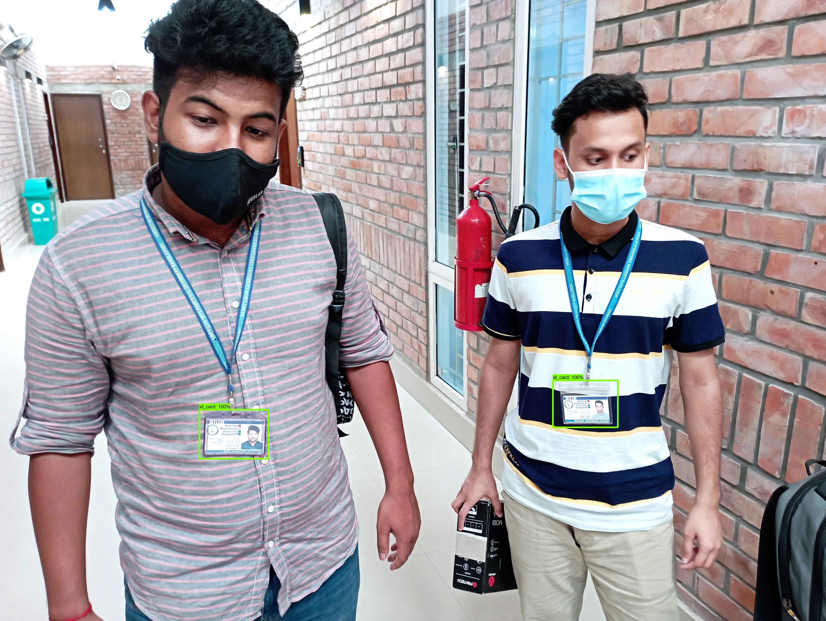

Detection Results

Slide 12
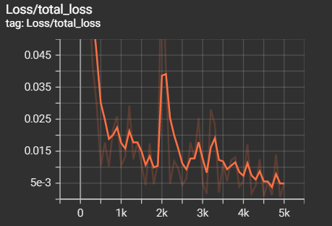
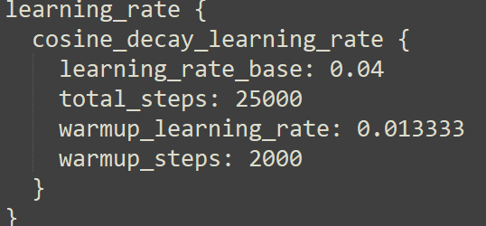
Future Work
Training on different model for real time detection
Hyper parameter tuning
Training with more Data

